Slide 1
Sentiment Analysis for World Cup 2022
Big Data
Josh, Zul, Ben
Notes:
Ben

Slide 2
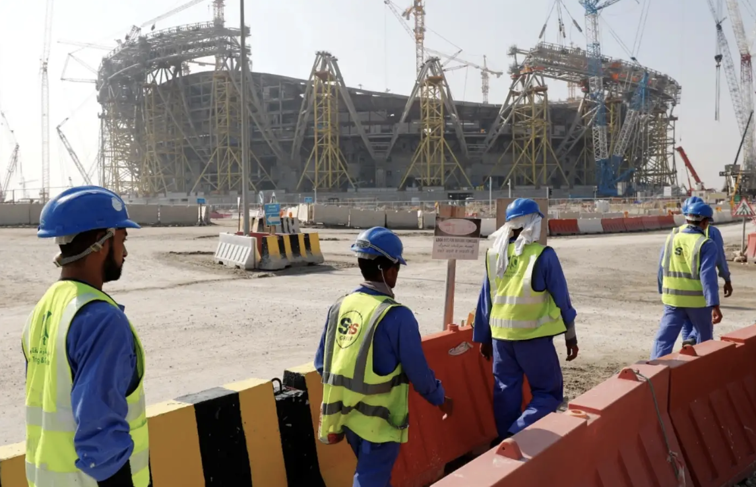
Background
Since the bid announcement of the World Cup location, 6,500 migrant workers from South Asia have died, but Qatar has told people that those people were working on projects unrelated to the stadium.
It is confirmed that between the 2014 to 2020 construction, 37 of the laborers working on the stadium passed away.
Since then, Qatar has made changes to its worker protections stopping them to work in extreme heat environments.
This report brought about a lot of discussions of the ethics of the World Cup and FIFA which is why we’re choosing to measure public opinion of the World Cup.
Notes:
Zul

Slide 3
Questions
How do sentiments expressed towards the 2022 Qatar World Cup compare to sentiments expressed towards the 2018 Russia World Cup?
How have sentiments expressed towards the 2022 Qatar World Cup changed over time (since it was announced to present day?)
Notes:
Ben

Slide 4
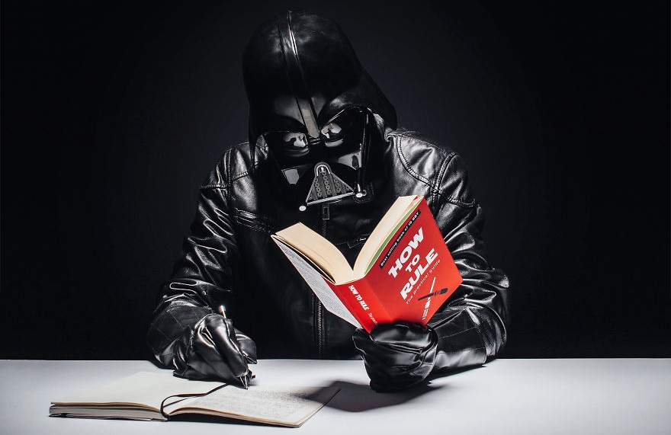




Resources
Reddit
Reddit API (Pushshift)
Vader Sentiment Analysis
Scikit Learn (RF)
Notes:
Ben

Slide 5
Coding, etc.
Pushshift API → scraping Reddit Data to get posts
Cleaning and Saving Data
Analyzing (Sentiment Intensity Analyzer, RF, Word Occurence)
Visualize (Matplotlib)
Compare with World Cup media coverage
Summarize findings in blog post
Notes:
Josh?

Slide 6
Insights &
Results
Notes:
Zul

Slide 7
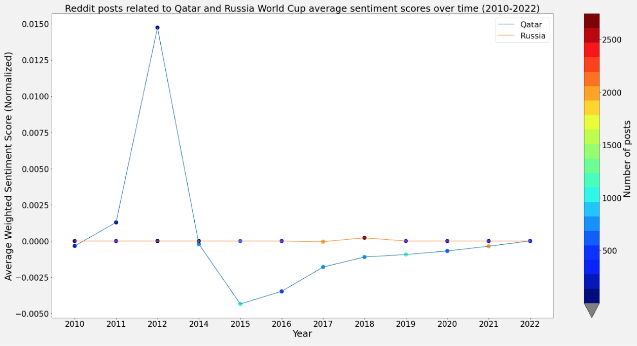
Results (Sentiment Analysis)
- Using VADER
- Calculate
weighted sentiment by multiplying compound sentiment score by normalized post ‘score’
- Take average for a year
- Results are between 0 and 1
Notes:
Josh

Slide 8
Sentiment Analysis Insights
There is a large increase in 2012 and we don’t really know the reasoning behind that. It could be another related to soccer in general. However, right after that small increase there is an extremely sharp decrease around 2015 which was the first reports of the deaths for migrant workers in Qatar. From there, there isn’t much except the stabilization of the sentiment towards neutral which can come from the other World Cups occurring and excitement about the current one.
The orange line is a representation of Russia and it show that there is a fairly neutral sentiment across the board. The one small increase that we see is near the 2018 World Cup where it goes slightly up.
Notes:
Zul

Slide 9
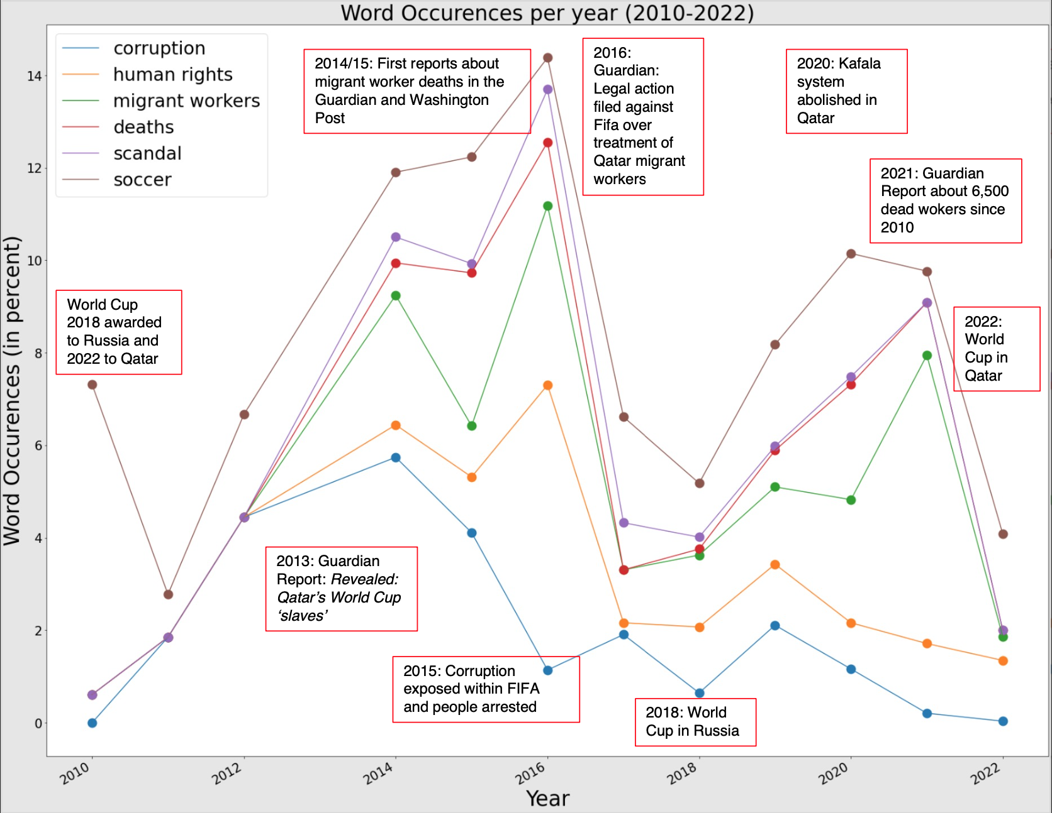
Results (Word Occurrences – Qatar)
Notes:
Ben

Slide 10
Word Occurrence Insights
Corruption is a strong and niche word to use for what is happening in Qatar, therefore, it would probably have the least mentions as it is not a direct word for what is happening. It is also important to note that there are still mentions of this, just very low amounts.
Soccer is the opposite which has the most occurrences. The reasons for this could be that the topic is still linked to soccer. Furthermore, Reddit appeals to a majorly english speaking audience which means it would focus on soccer rather than a term like football.
Notes:
Zul

Slide 11

Random Forest Model
Goal ⚽
Input
Variable to predict
Output
Predict whether a world cup related reddit post will be ‘viral’ or not based on its content.
Analyze model feature importance to determine what words are most related to predicting viral content.
Do for both Qatar and Russia and compare
TFIDF vector representing each post
“Virality”: sum of post ‘score’ and number of comments
Split into two categories:
Not viral (score < 2)
Viral (score > 50)
Needed to balance size of classes!!
Whether a post belongs to category 0 (not viral) or category 1 (viral)
Notes:
Josh

Slide 12
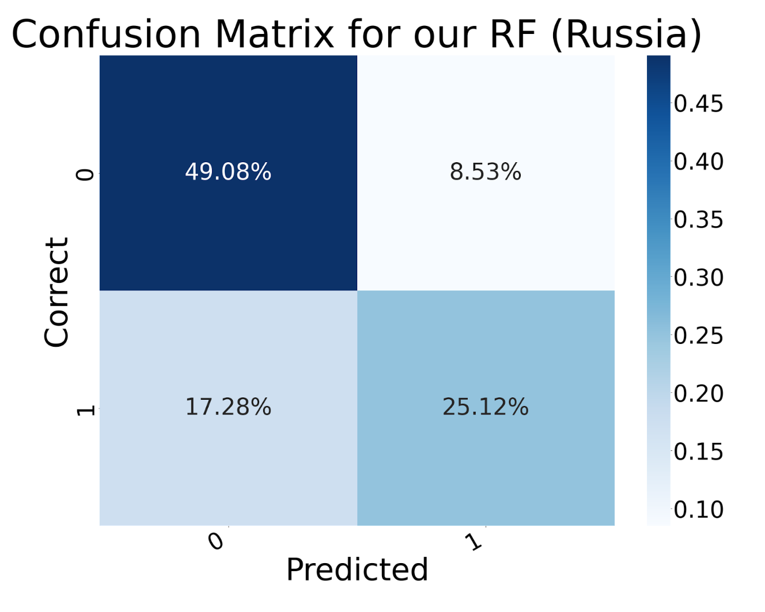
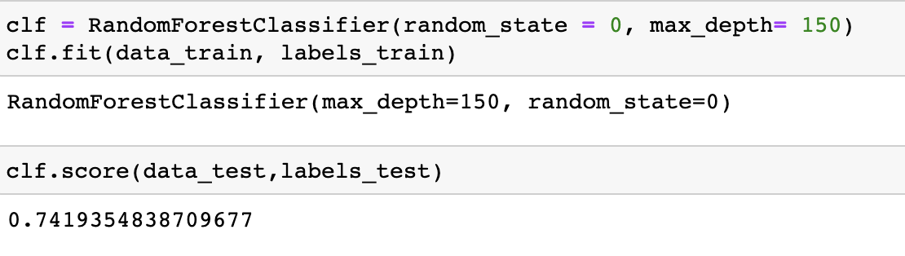
Results (RF) Russia
Notes:
74% test accuracy (Josh)

Slide 13
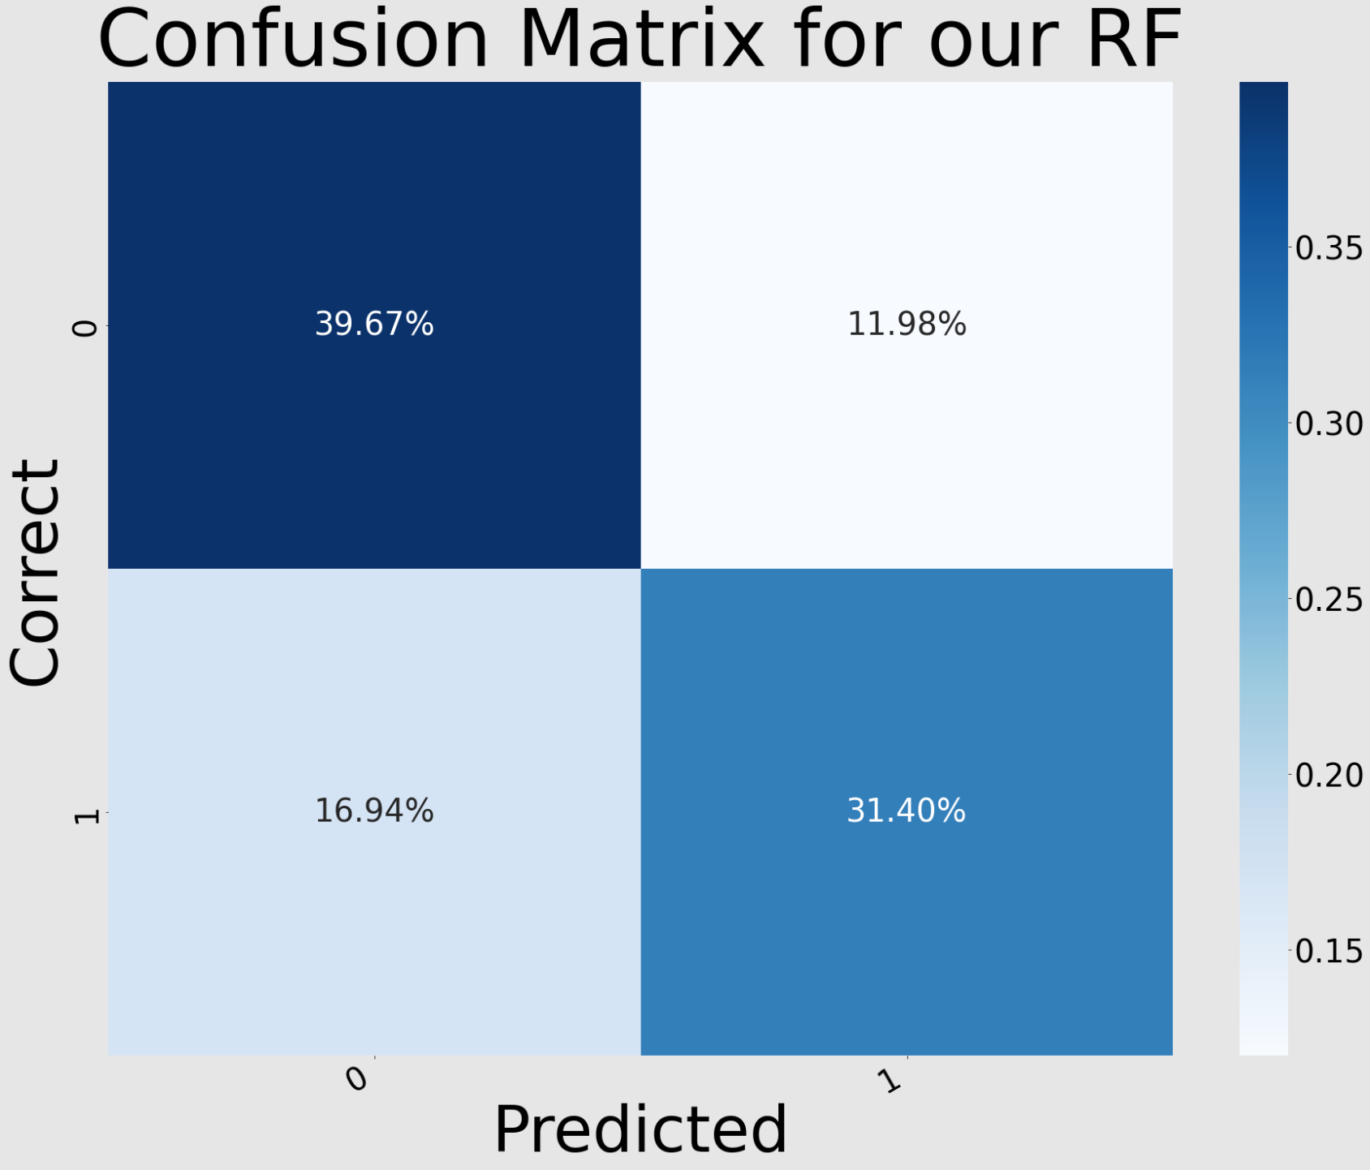
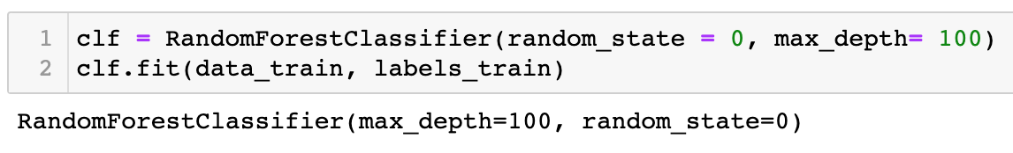
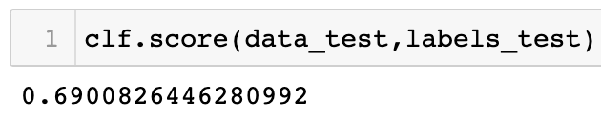
Results (RF) Qatar
Notes:
69% test accuracy (Ben)

Slide 14
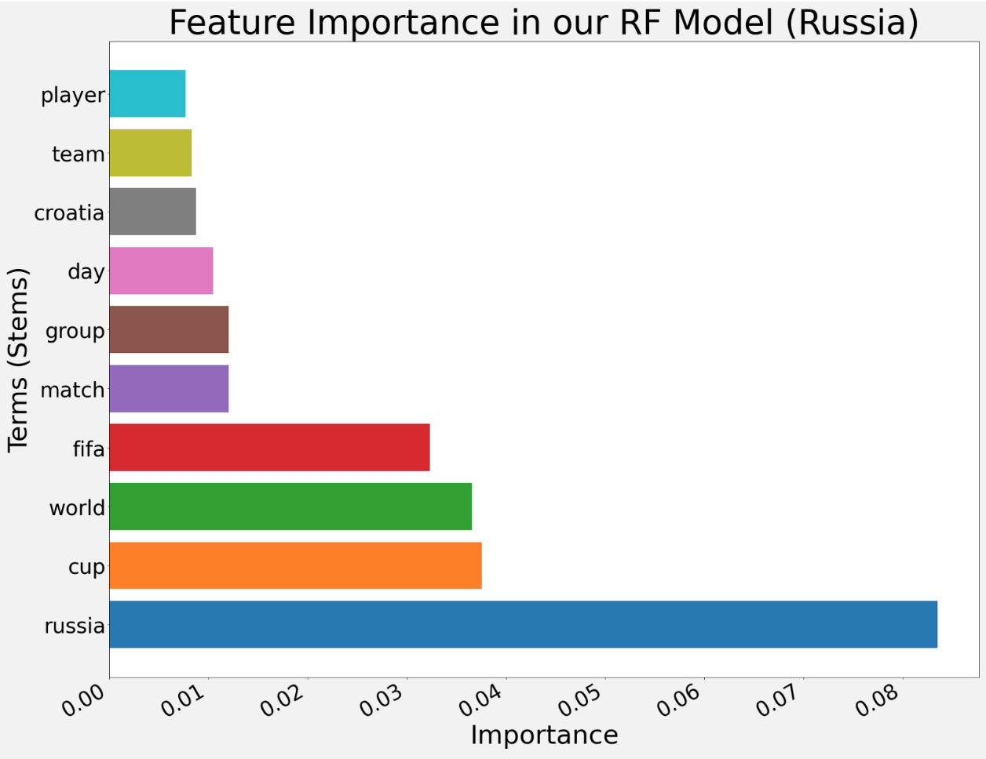
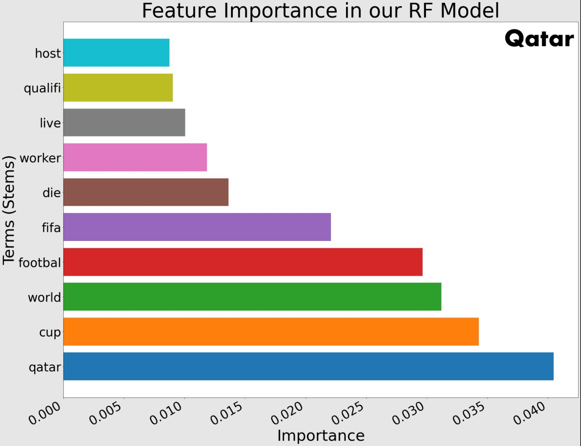
Results (RF)
Notes:
Josh & Ben

Slide 15
Feature Importance Insights
Within both feature importance graphs we can see that the own country has the strongest importance which we can use as a control for the graph. On Russia’s graph we can see that there’s not much mention other than the logistics and technicality of the graph.
However, it is an entirely different story for Qatar: terms like ‘migrant’ or ‘die’ hold a medium level of importance over the words which is interesting since that means we can chalk up some correlation between the two topics.
Notes:
Zul

Slide 16
Conclusion
Our sentiment analysis of the 2022 FIFA Qatar World Cup shows the majority online comments reflect excitement and anticipation for the tournament right now through the occurrence of words.
However, there are also a significant number of negative sentiments, mostly centered around the issue of human rights and the treatment of migrant workers in Qatar discussed in this post.
Overall, it seems that the World Cup is generating a mixed response among the public.
Notes:
Zul

Slide 17
THANK
YOU
Q&A
Notes:
All

